Slide 1

Disorder: 1820-1854

Slide 2
As you look at the following sets of “before” and “after” images from the period 1820-1854:
Observe the differences between the image on the left and the one on the right
Predict what circumstances led to the change or changes you observed

Slide 3
Article III: Pennsylvania Constitution
1790
1838
In elections by the citizens, every freeman of the age of twenty-one years, having resided in the state two years next before the election… shall enjoy the rights of an elector.
In elections by the citizens, every white freeman of the age of twenty-one years, having resided in the state one year… shall enjoy the rights of an elector.

Slide 4
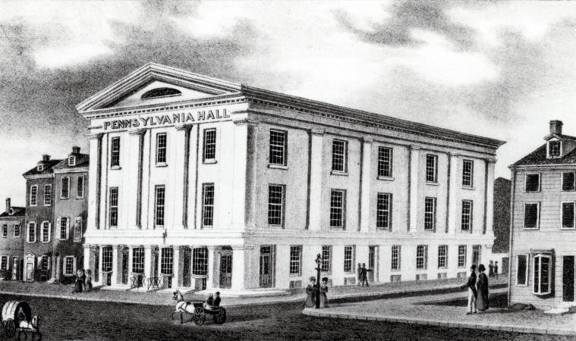
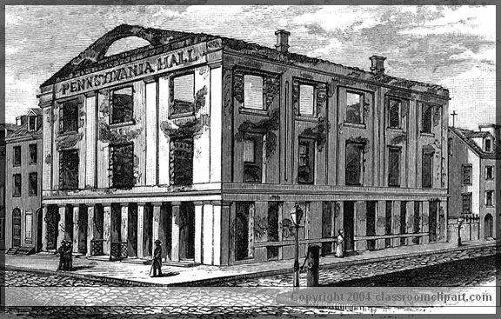
Pennsylvania Hall

Slide 5
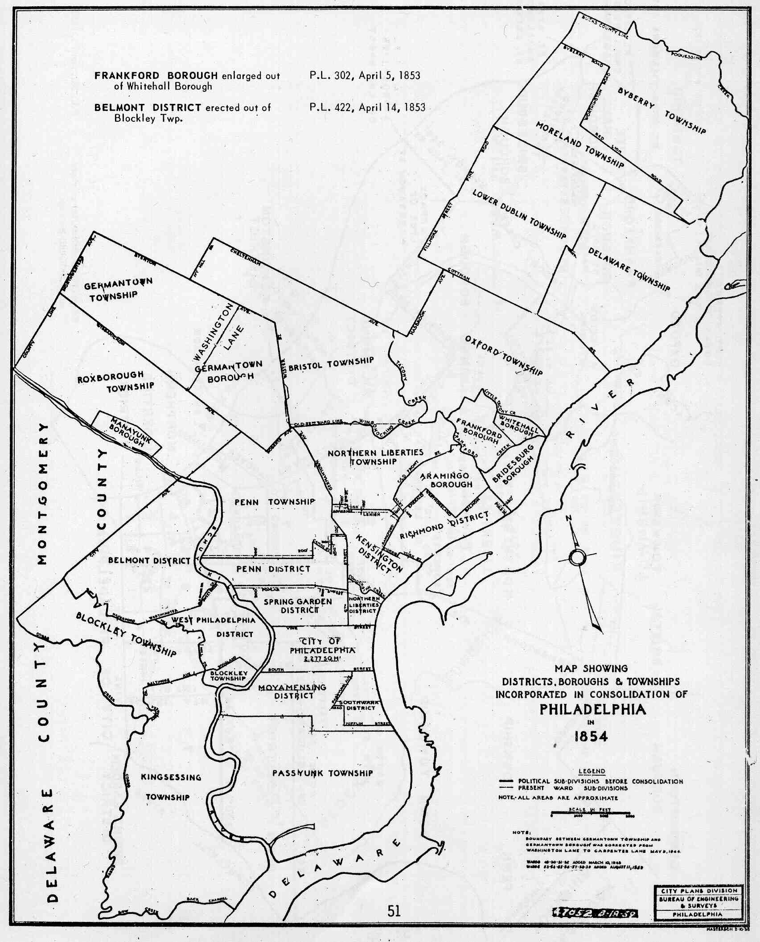

Philadelphia County

