Slide 1
A Lost World: 1600-1680

Slide 2
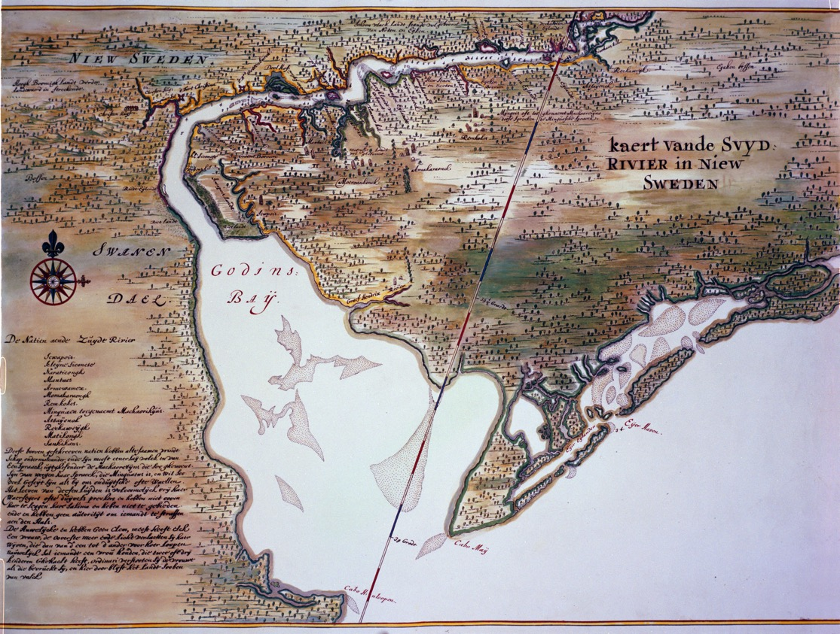
What region is shown in this 1640 Dutch map?

Slide 3
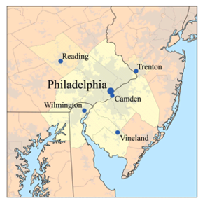

How’d you do?

Slide 4

How do YOU picture:
The native people who lived in the Delaware River region before European settlement?
Europeans who came to the region in the 1600s?

Slide 5
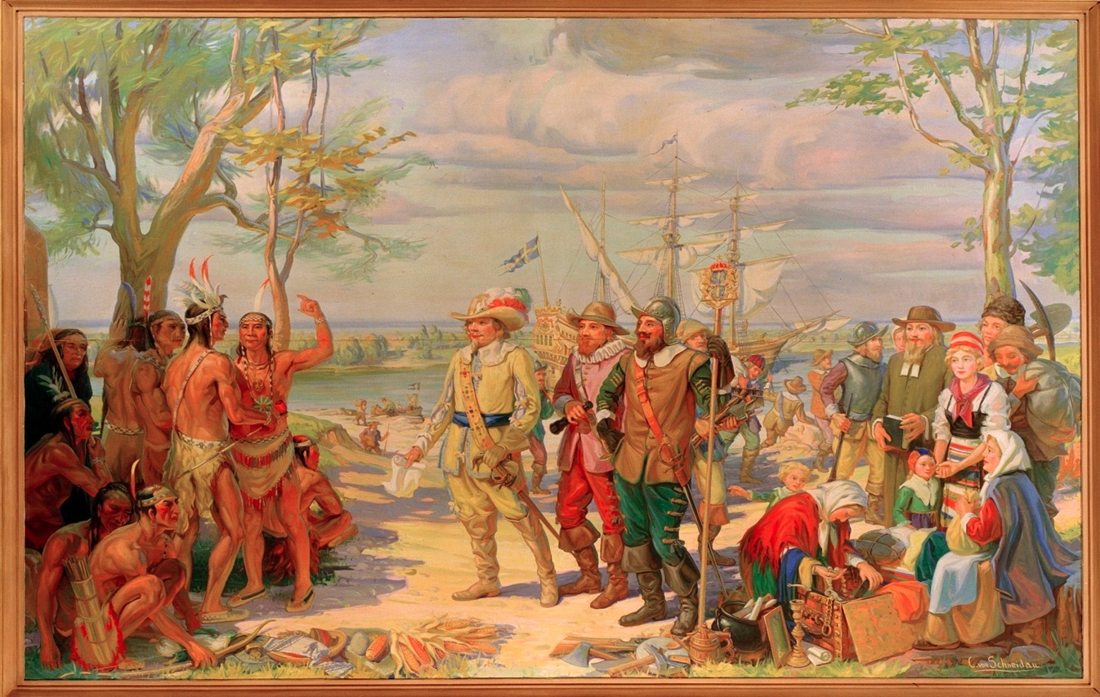
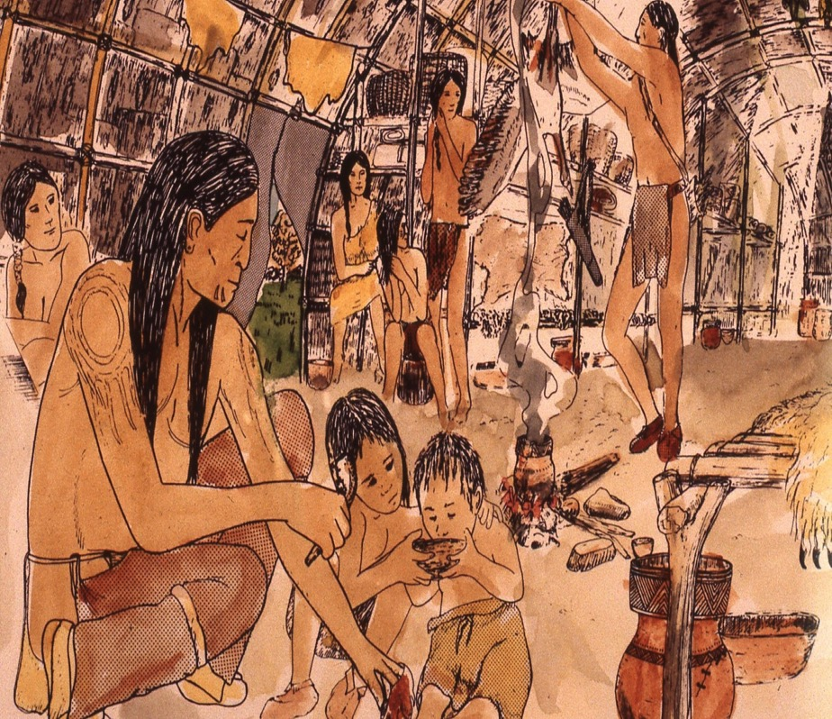
Which do you think is more accurate? Why?
Notes:
Note that the image on the right is almost or entirely male and most men are armed and wearing feathers. In the image on the right, a man is helping with child care and both genders and varied ages are shown. The image on the right, Family in Wigwam, was completed recently by John Kraft, a Lenape educator, and is based on extensive research and fieldwork. Additional works by Kraft are available on our website.

Slide 6

What do you think this image shows about WHY these Europeans have come to the New World?
Notes:
This is an image of The Landing of the Swedes on the Delaware, a ceiling mural painted in 1928 by Christian von Schneidau for the opening of the American Swedish Historical Museum in Philadelphia. The telescope indicates exploration; the staff and the sword show a desire for conquest. A man with an collar and hat may be holding a bible in order to convert the natives to Christianity. The men behind him have farming implements. The older woman is looking at goods in a box that are unlike those owned by the natives, possibly to trade. Note that this work has many inaccuracies: no women nor children took part in the early Swedish voyages; the Swedes are much more dressed up (and clean!) than would make sense for people at the end of a long sea voyage. The Lenape sachems who first met the Swedes would likes have been older.

Slide 7
It’s time to learn about a
“Lost World”.

