Slide 1

John Lewis Krimmel:
Everyday Life in Early 19th Century Philadelphia

Slide 2
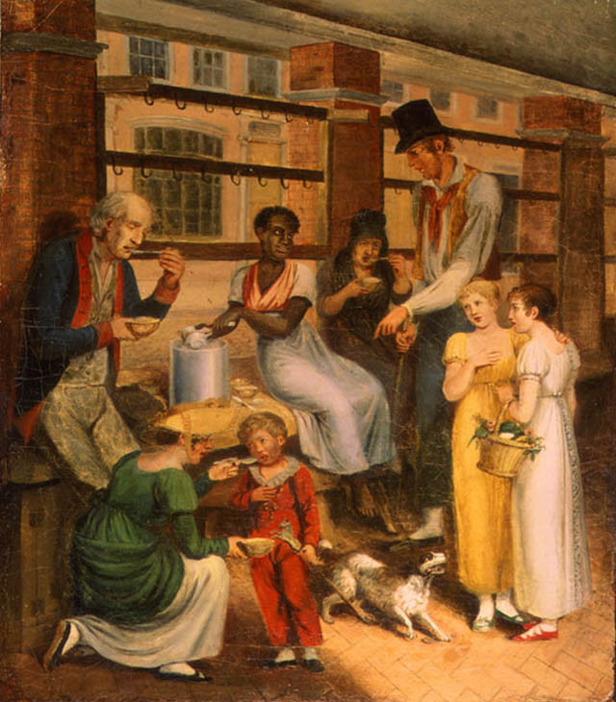
Pepper-Pot:
A Scene in the
Philadelphia
Market,
1811

Slide 3
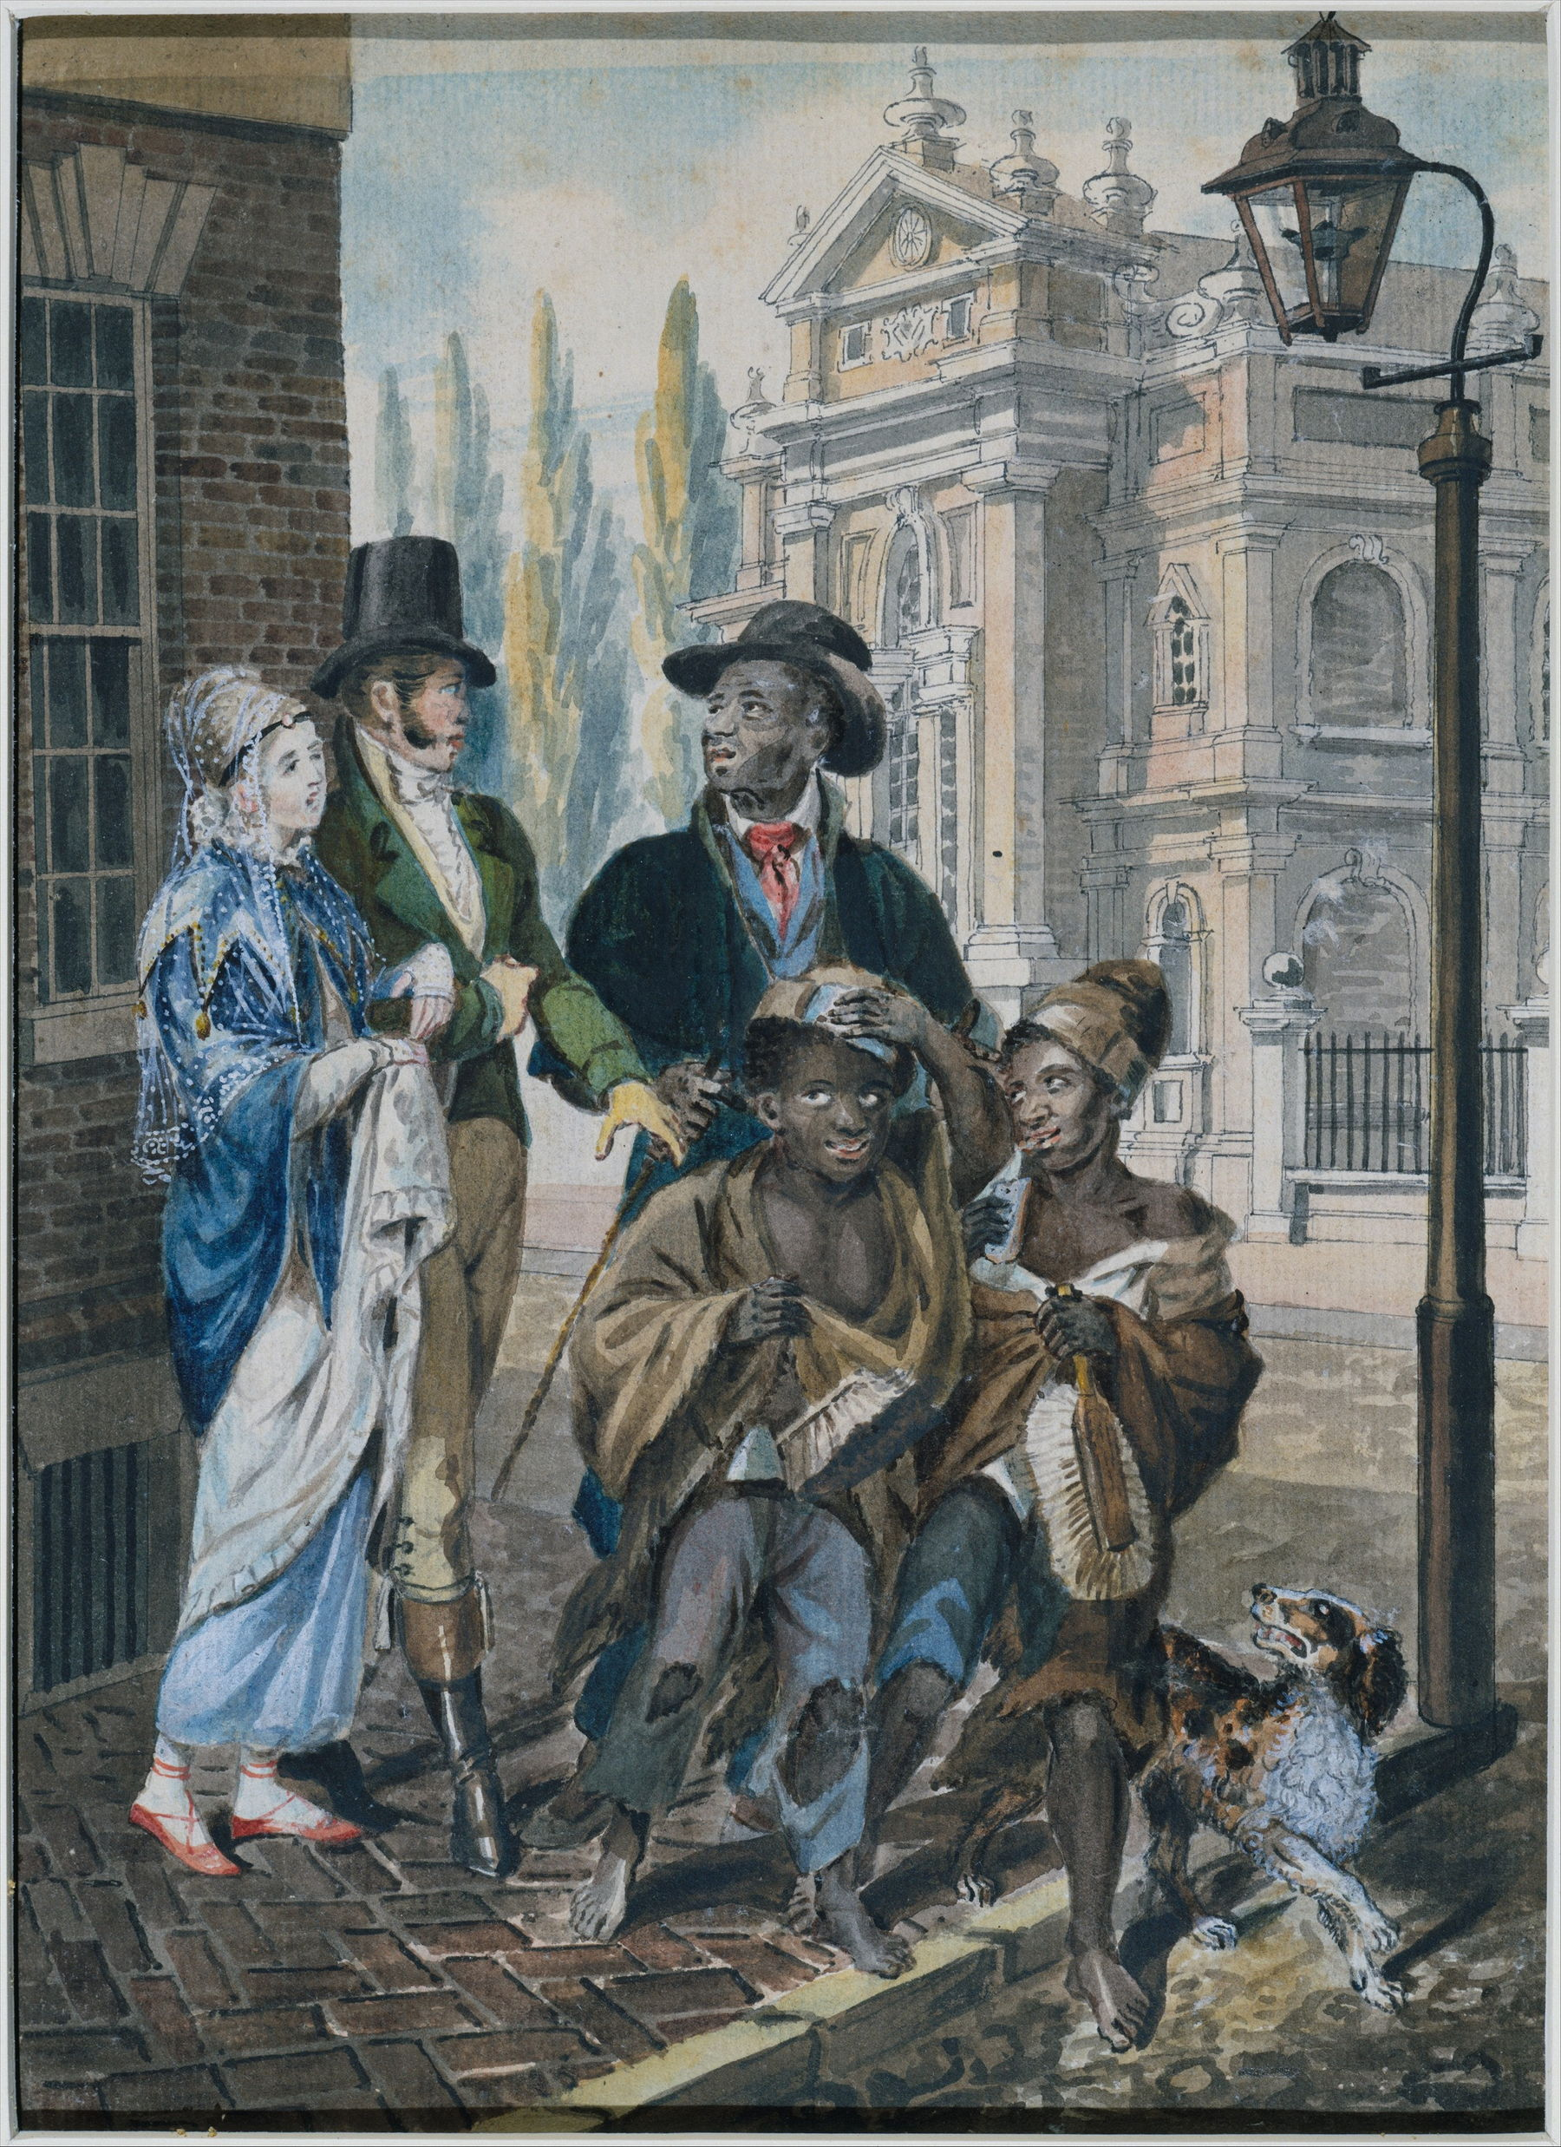
Worldly Folk
Questioning
Chimney
Sweeps &
Their Master
Before Christ
Church in
Philadelphia,
1813

Slide 4
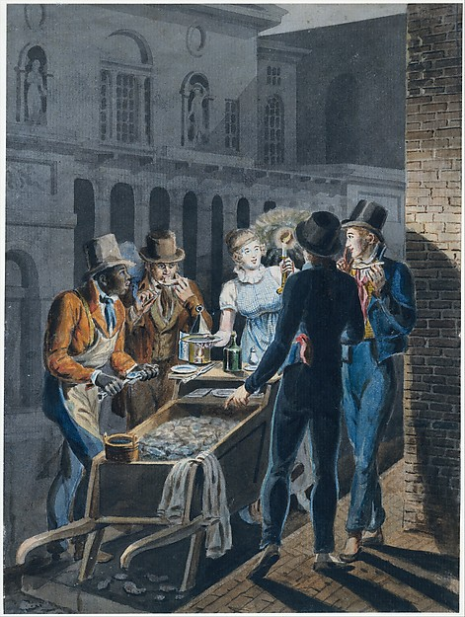
Nightlife in
Philadelphia-
An Oyster
Barrow in front of the Chestnut
Street Theater,
1813

Slide 5
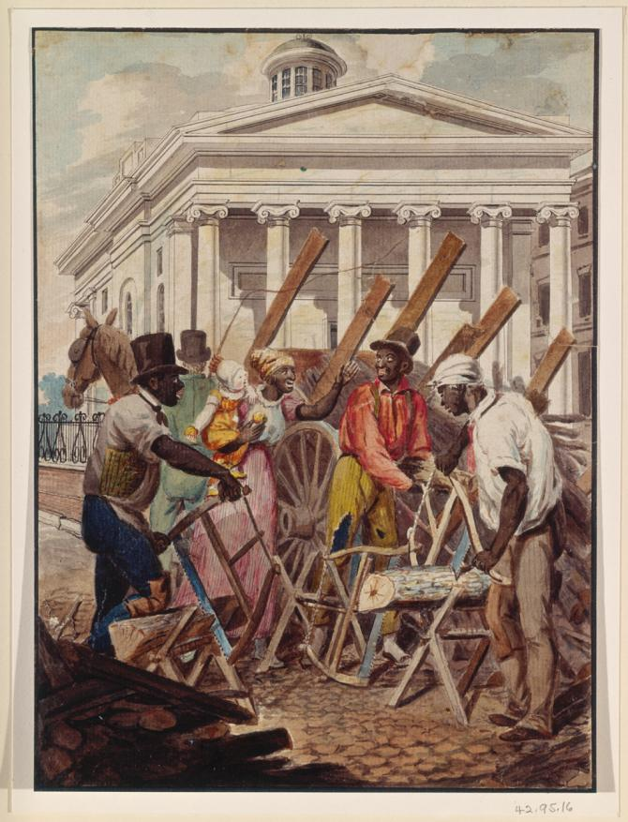
Black
Sawyers
Working in Front of the Bank of
Pennsylvania,
1813

Slide 6
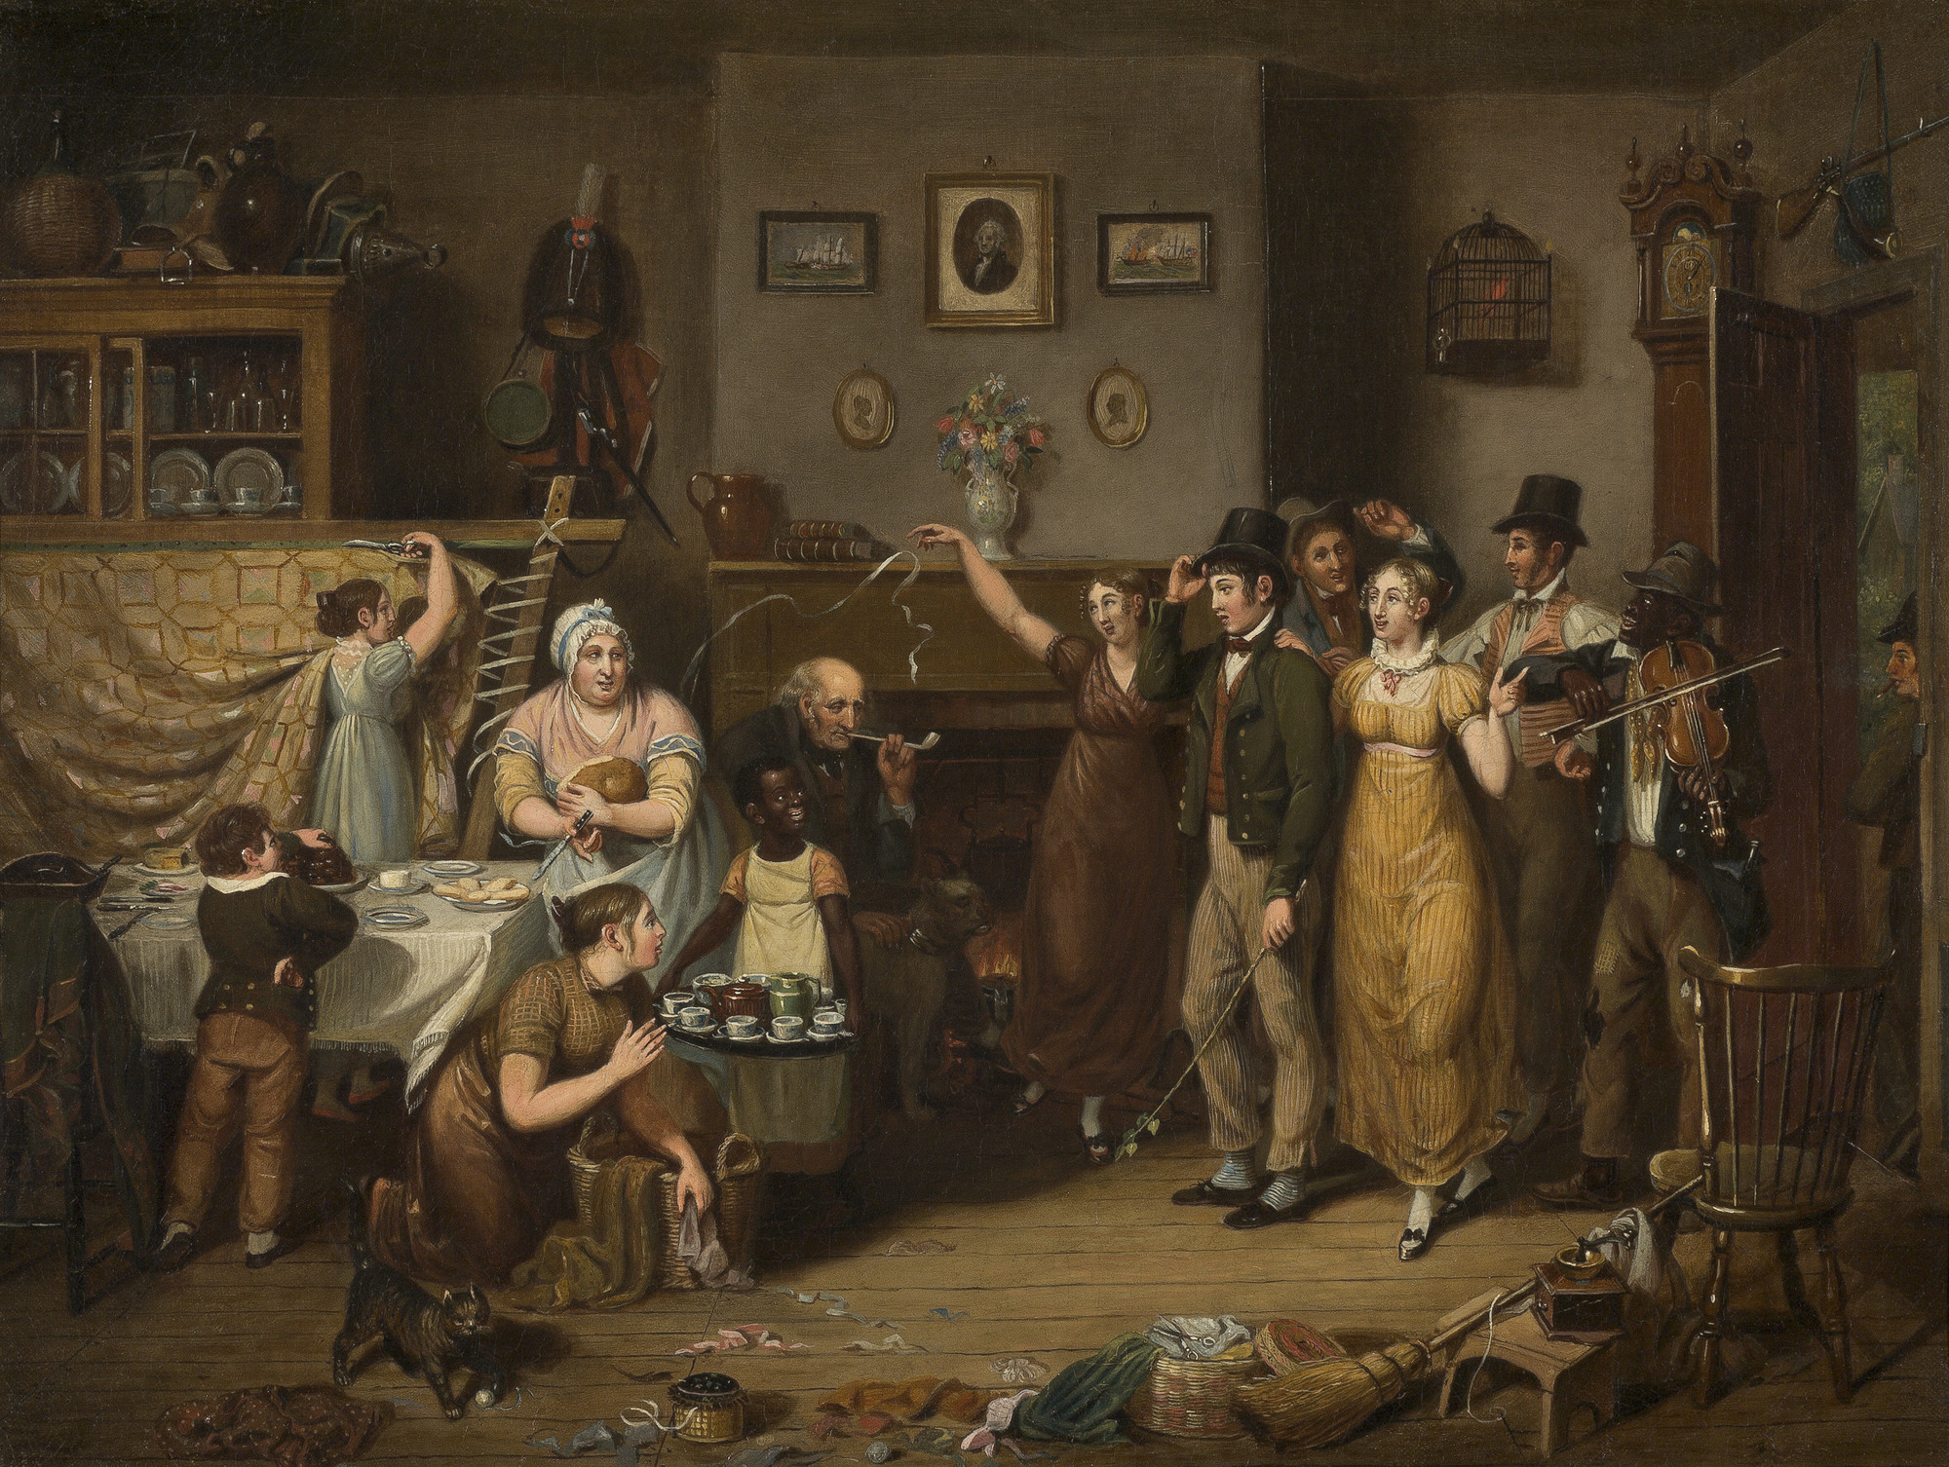
The Quilting Frolic, 1813

Slide 7
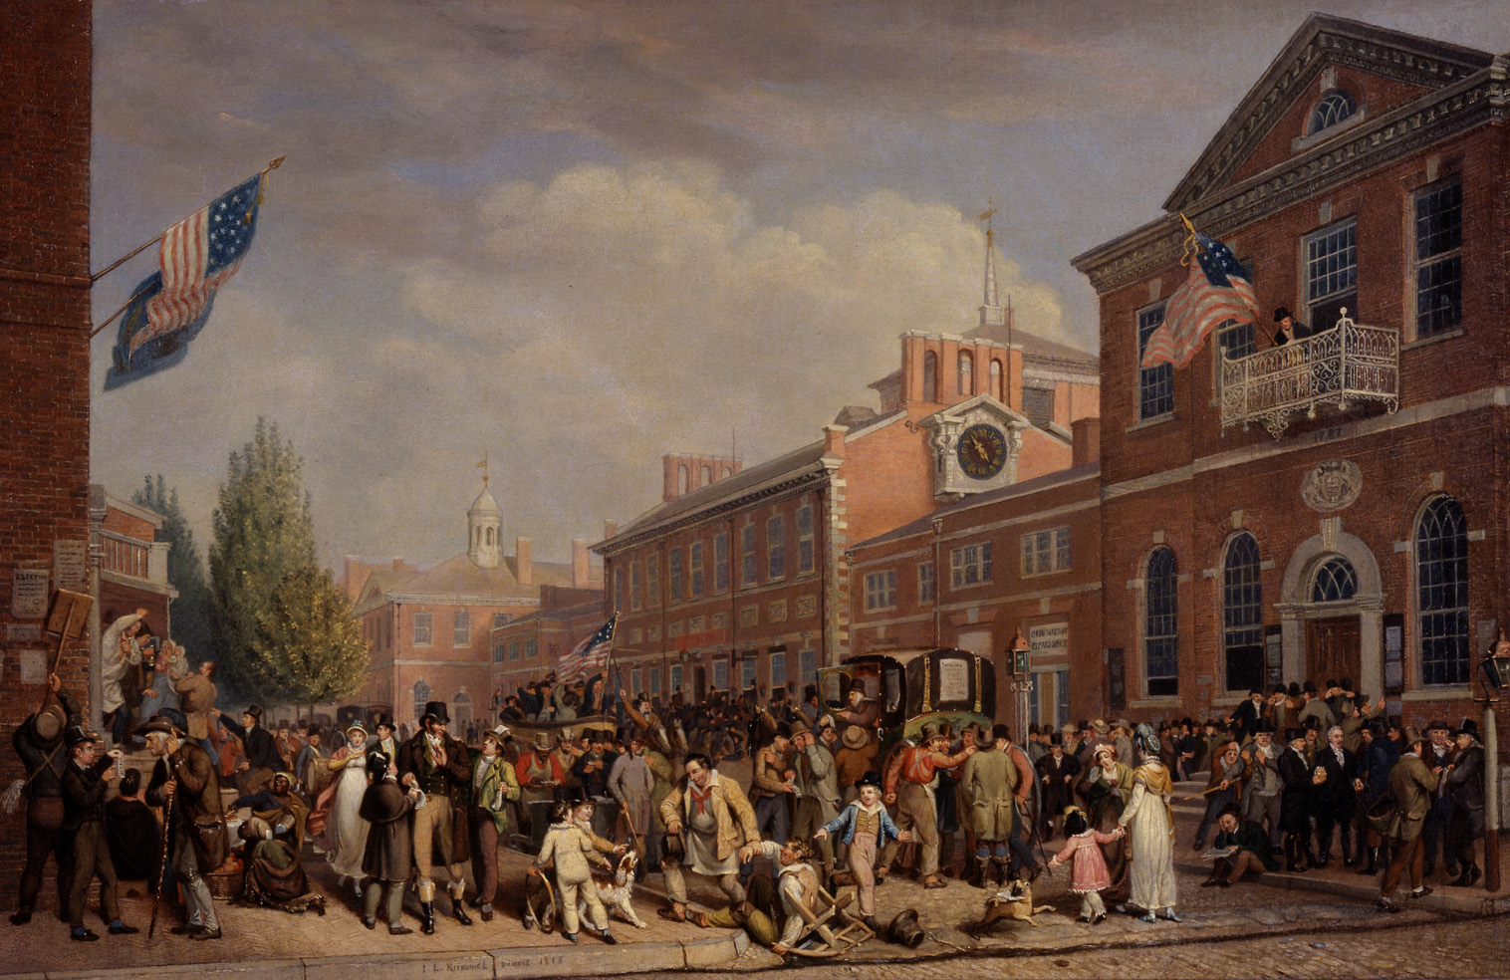
Election Day, 1815

Slide 8
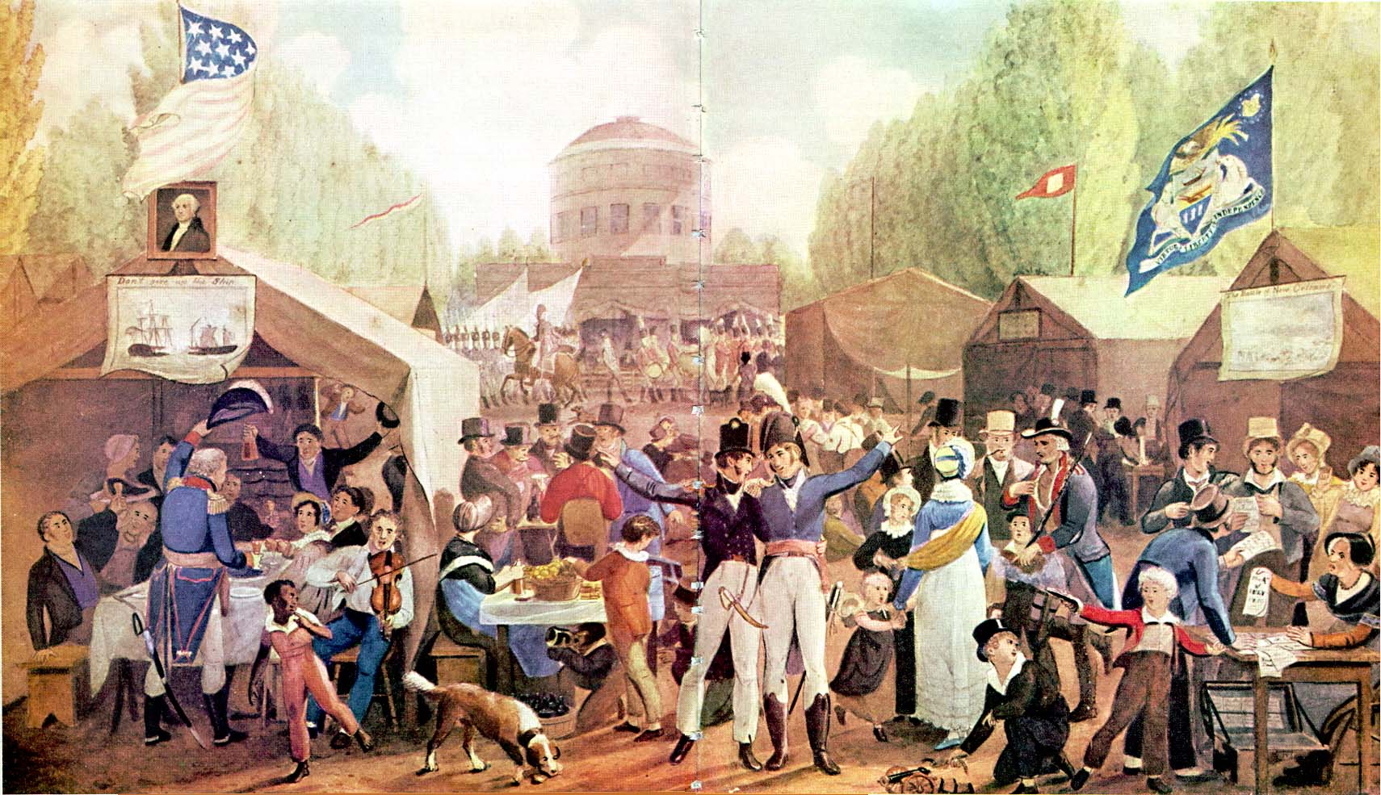
Fourth of July Celebration in Centre Square, 1819

Slide 9
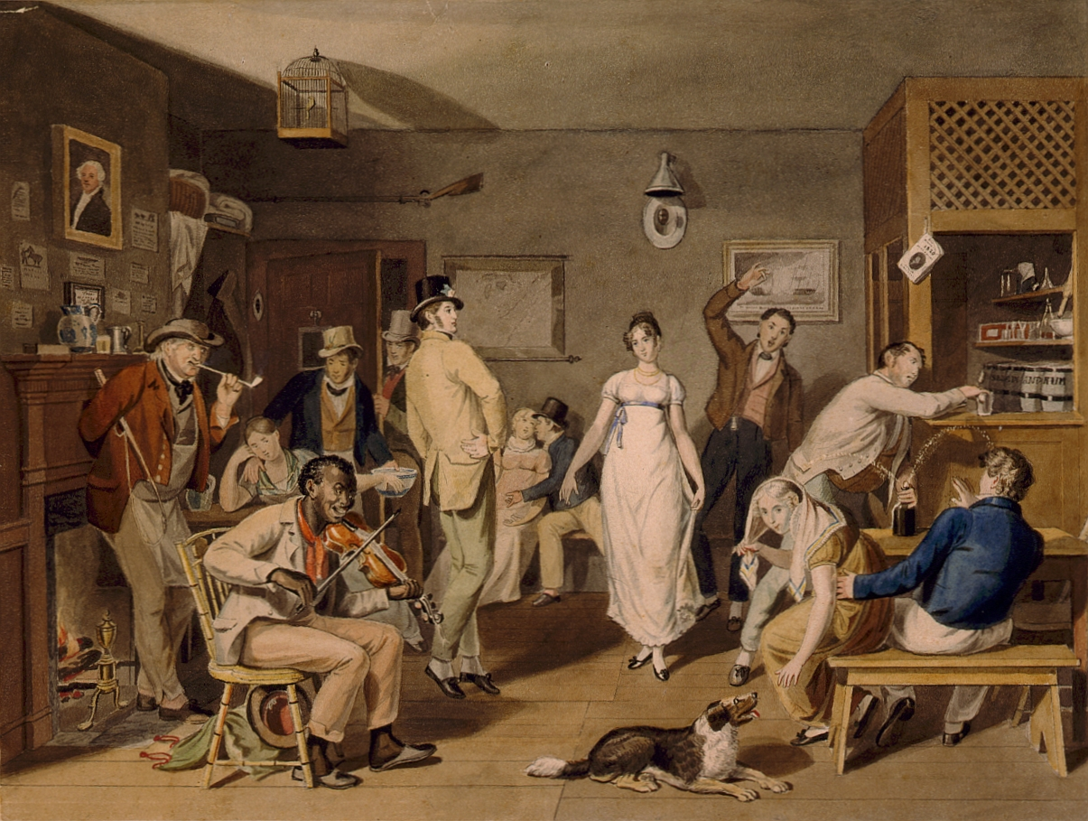
Barroom Dancing, 1820

