Slide 1
Imagine being able to design the ideal city….
What would it look like?
Who would live there?
On what would the economy be based?

Slide 2
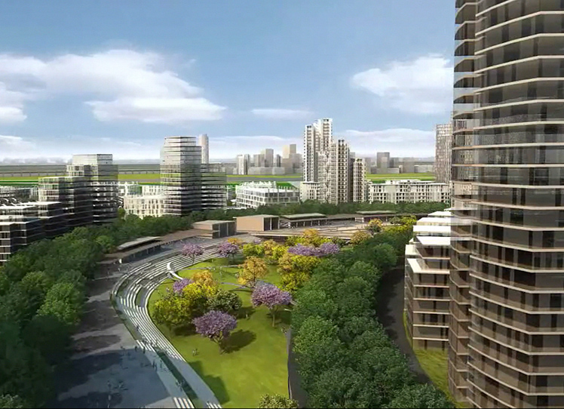
Would it be clean and efficient like Jaypee Greens Sports City in India?
Notes:
This is a city under development in India. In addition to schools, hospitals, town homes and apartment buildings, it will have golf courses, cricket fields, and many other indoor and outdoor sport facilities. See jaypeegreens.com for more information.

Slide 3
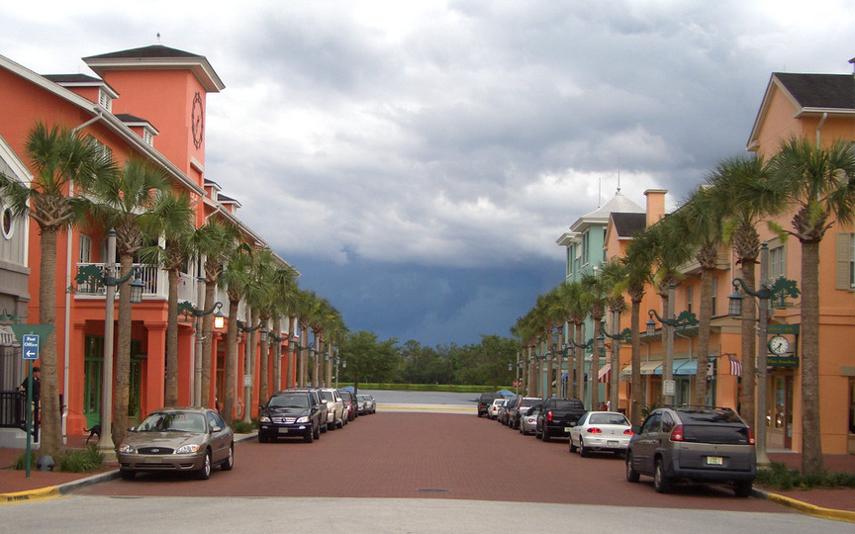
Would it be bright and neighborly like Celebration, Florida?
Notes:
Developed by the Walt Disney Company in the 1990s, Celebration is an attempt to create the perfect hometown for it’s 7,500+ residents.

Slide 4
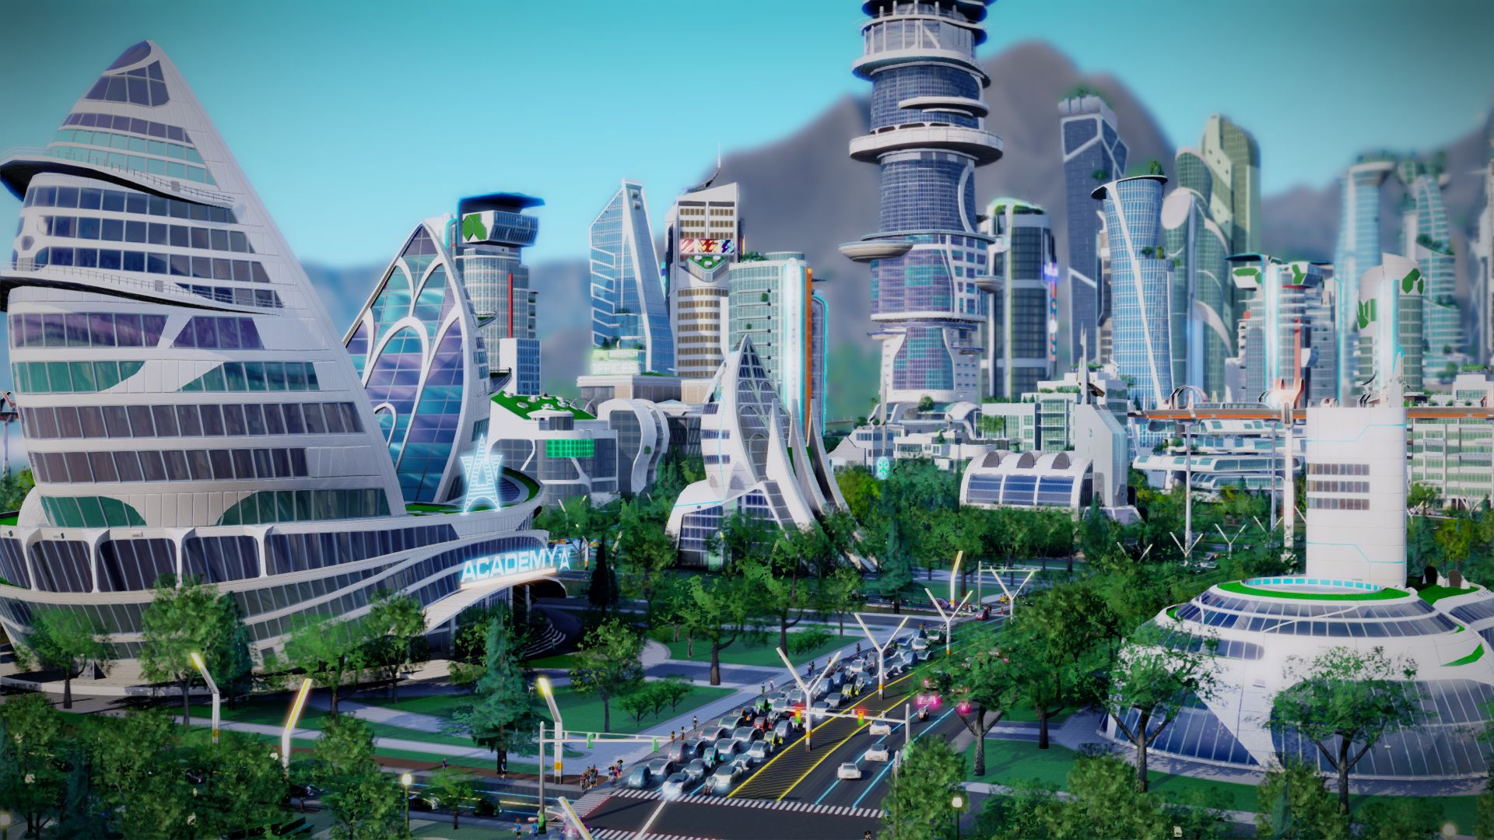
Would it be something that’s never existed before?

Slide 5
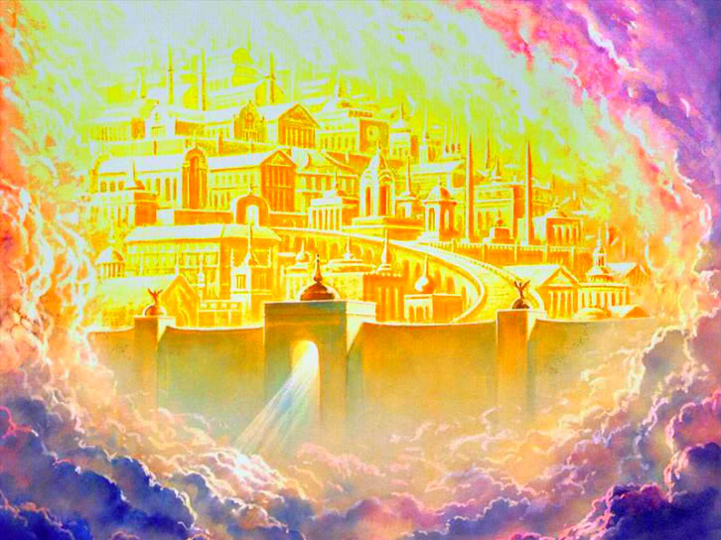
Or would it be a “Heaven on Earth”?
Notes:
The New Jerusalem, mentioned in several parts of the Bible, is described as a city that is a heaven on earth.

Slide 6
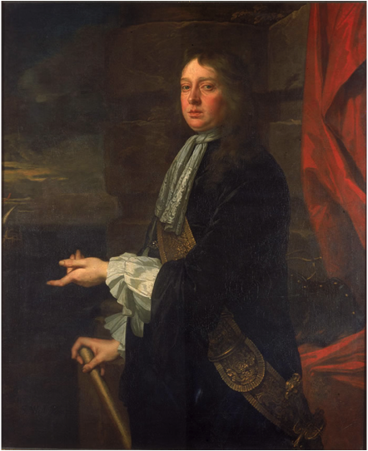
Meet William Penn:
Expelled from college
Kicked out of his home by his parents
Arrested & jailed numerous times

Slide 7
Meet William Penn:
A man who chose to leave his parents’ religion and later his home country.
A man who was given the chance to found a new city.
A man who strove to make this new city…

Slide 8
The New Jerusalem

Slide 9
Let’s take a look at the city, the expected “New Jerusalem” that developed….
…In William Penn’s Shadow

