Slide 1
The Promise for a Better City

Slide 2
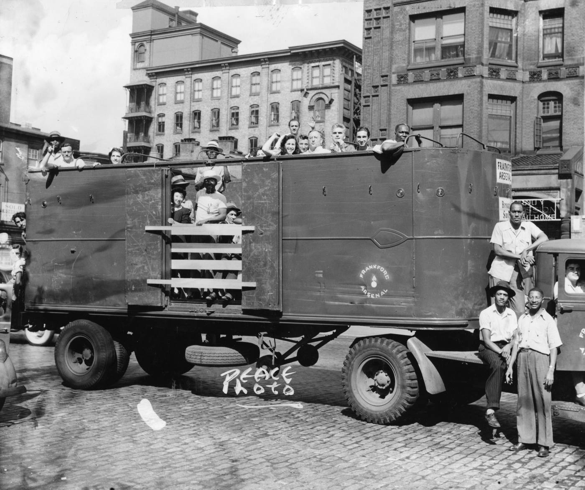
Philadelphia: August, 1944
What do you see in this image?
What do you think is going on?

Slide 3
What are the characteristics of a great city?

Slide 4
In the mid-20th century, Philadelphians tried to improve their city by:
Expanding job opportunities for African Americans
Getting rid of corruption in city government
Creating a clean, modern, attractive center city
Encouraging a peaceful coexistence among diverse people

Slide 5
Which image illustrates which of these four goals?

Slide 6
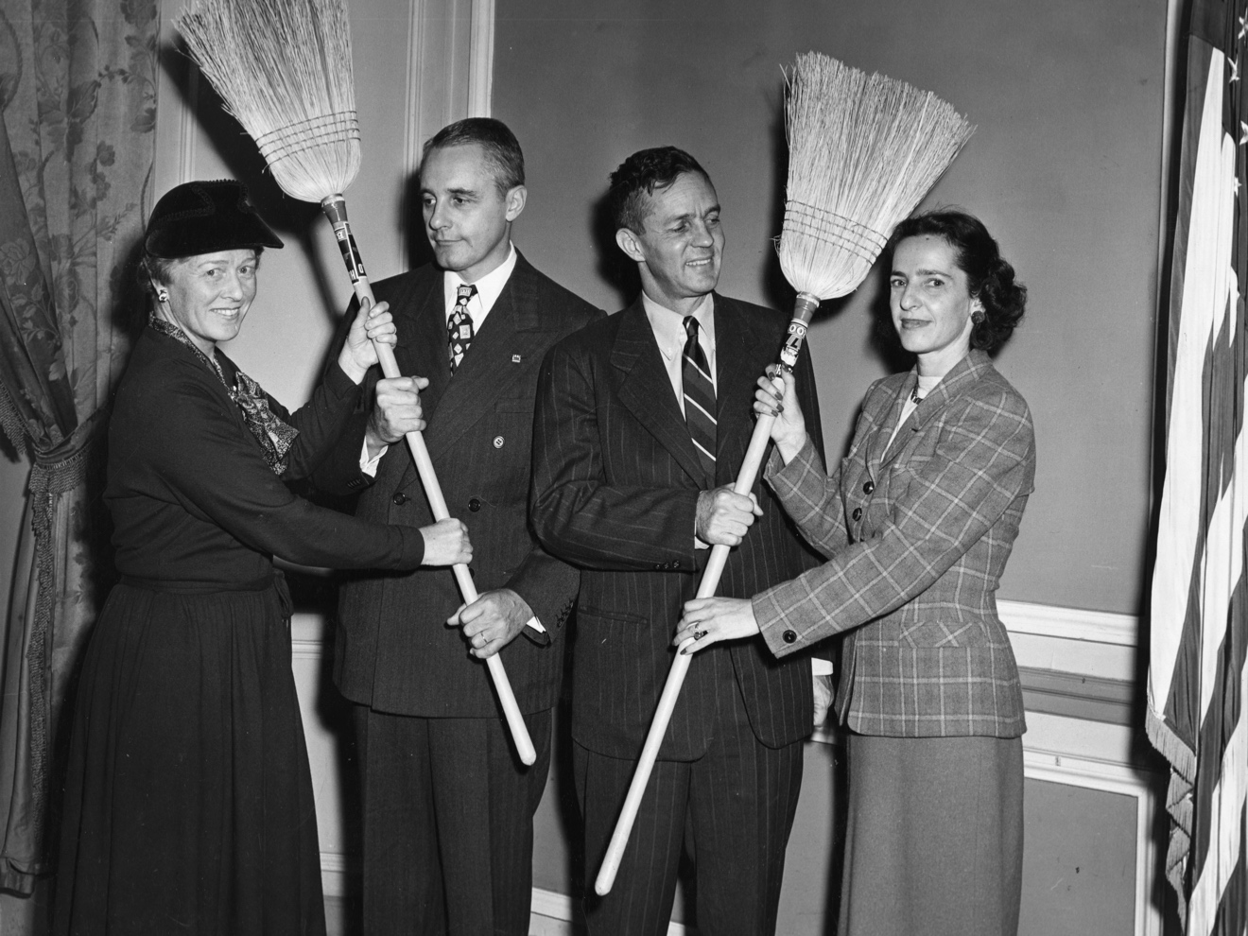
Expanding job opportunities for African Americans
Getting rid of corruption in city government
Creating a clean, modern, attractive center city
Encouraging a peaceful coexistence among diverse people

Slide 7
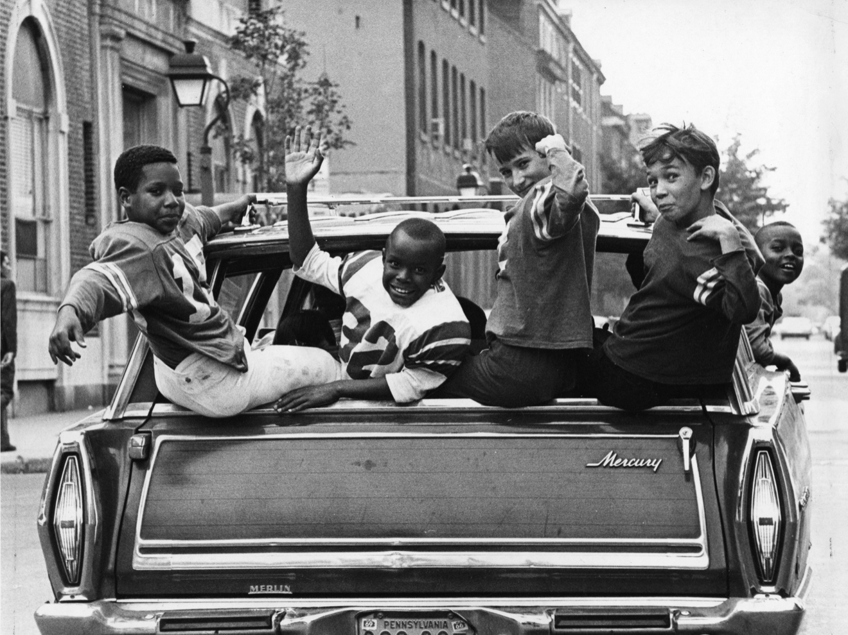
Expanding job opportunities for African Americans
Getting rid of corruption in city government
Creating a clean, modern, attractive center city
Encouraging a peaceful coexistence among diverse people

Slide 8
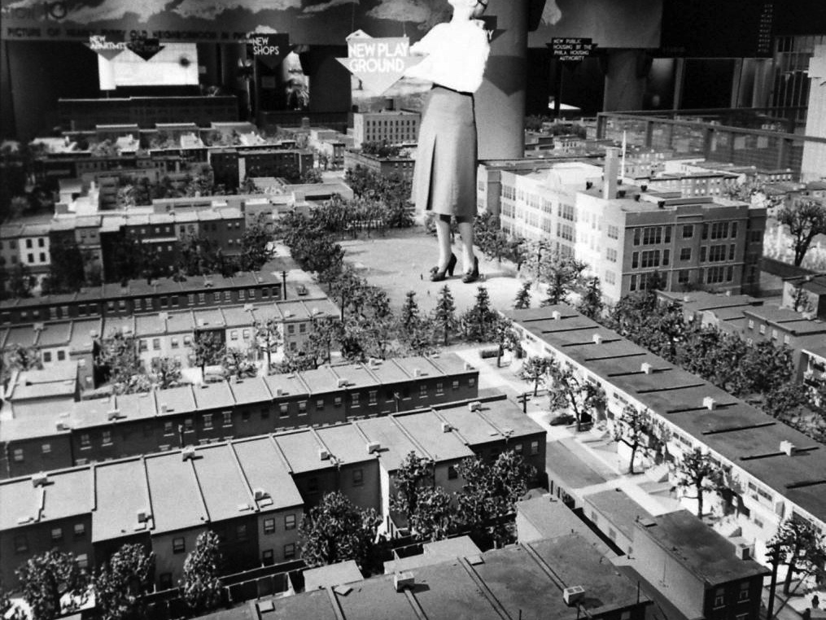
Expanding job opportunities for African Americans
Getting rid of corruption in city government
Creating a clean, modern, attractive center city
Encouraging a peaceful coexistence among diverse people

Slide 9
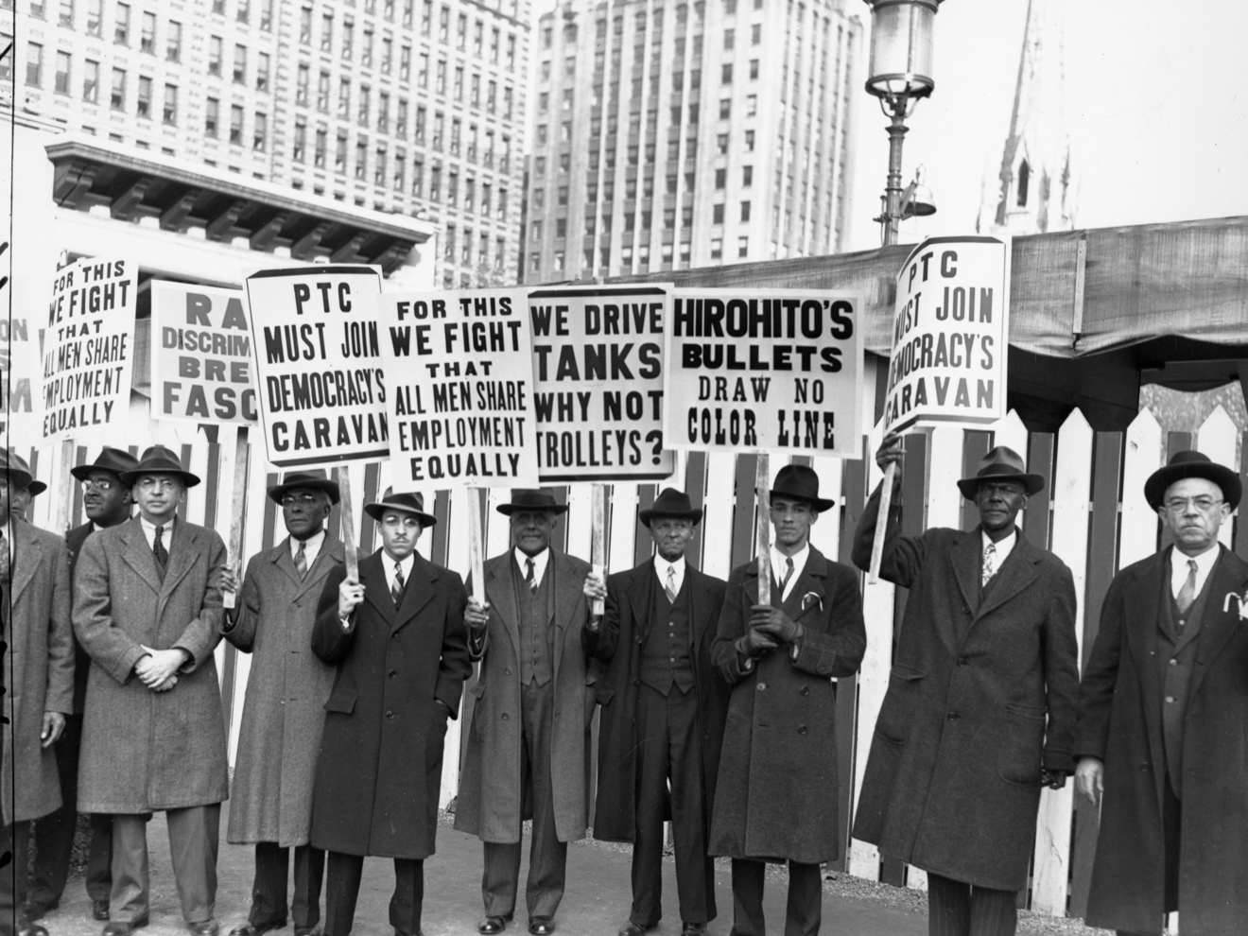
Expanding job opportunities for African Americans
Getting rid of corruption in city government
Creating a clean, modern, attractive center city
Encouraging a peaceful coexistence among diverse people

